Slide 1


Bank management system
By:
Param jani 19dcs042
Ishaan padmashali 19dcs069
Alap pandya 19dcs073

Slide 2
Project definition
The bank management system is an application for maintaining a person’s account in a bank.
The system provides the access to the customer to create an account, deposit/withdraw the cash from his account, also to view reports of all accounts present.
The following presentation provides the specification for the system.

Slide 3
Description
The Bank Management System is a software created to improve a customer’s banking experience.
It nurtures the needs of an end banking user by providing a better way to perform banking tasks.
An efficient interface has been developed to make management easy and quick, which is not possible with the manual systems.
The software gives the user complete access and control to their account.

Slide 4
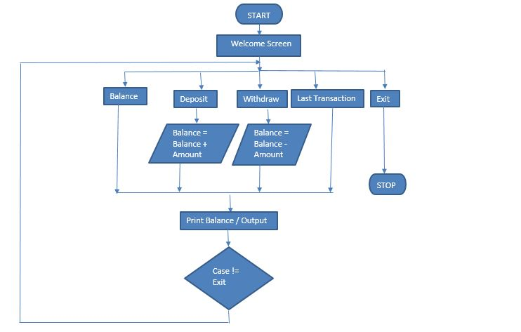
Flowchart

Slide 5
System requirements
Software:
Windows 7 onwards (in small screen, no graphic card requirement)
Minimum 256 MB
Minimum 10 MB of space
Java Development kit (latest version suggested)
Eclipse IDE, NetBeans, Visual Studio Code, Scite, Notepad
Hardware:
Core i3 Processor
RAM 2 GB
HDD Capacity 500GB

Slide 6
Limitations
Technology and Service Interruptions
Security and Identity Theft Concerns
Limitations on Deposits
Convenient but Not Always Faster
Lack of Personal Banker Relationship
A Limited Scope of Services

Slide 7
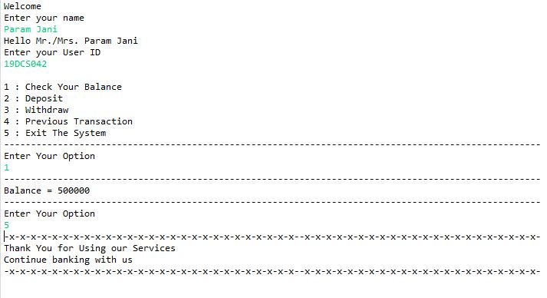
output of balance check

Slide 8
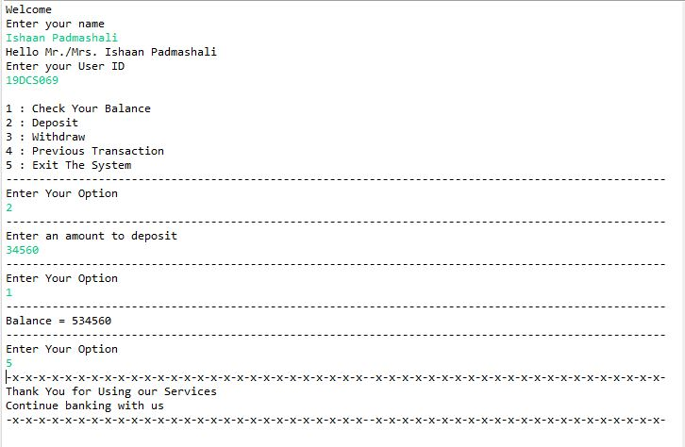
output of deposit & balance check

Slide 9
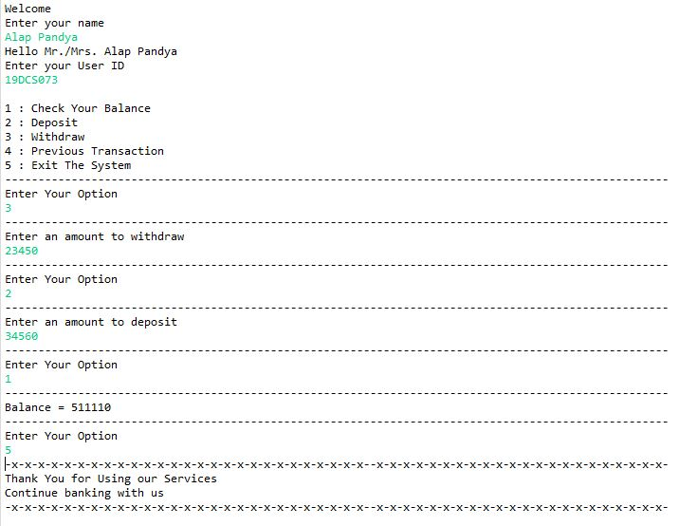
Output of withdrawal along with deposit

Slide 10
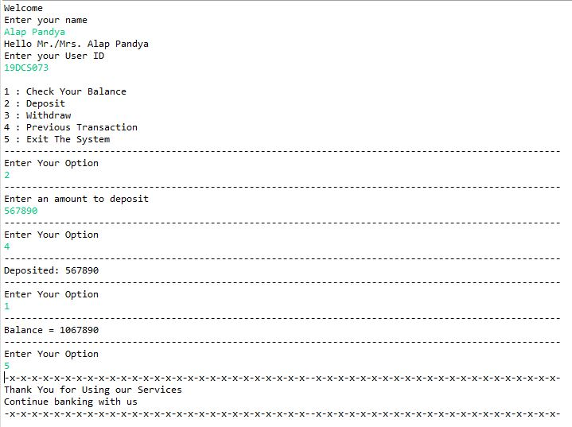
Output of previous transaction

Slide 11
References
https://www.w3schools.com/java/java_switch.asp
https://www.tutorialspoint.com/cprogramming/c_do_while_loop.htm
https://www.geeksforgeeks.org/methods-in-java/
https://www.youtube.com/watch?v=HmF3yQ_nj5Q
https://www.oracle.com/in/java/technologies/javase-downloads.html

Slide 12
Thank you !

